Slide 1

Nulltime
The greatest game ever made

Slide 2
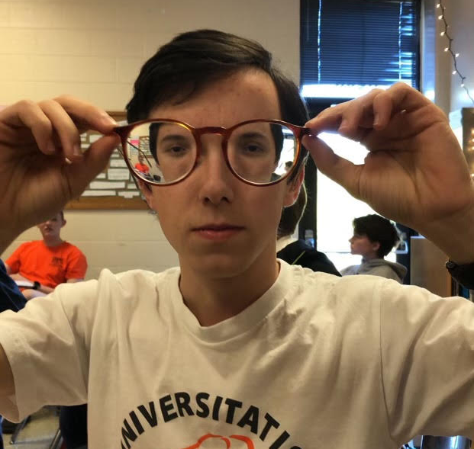
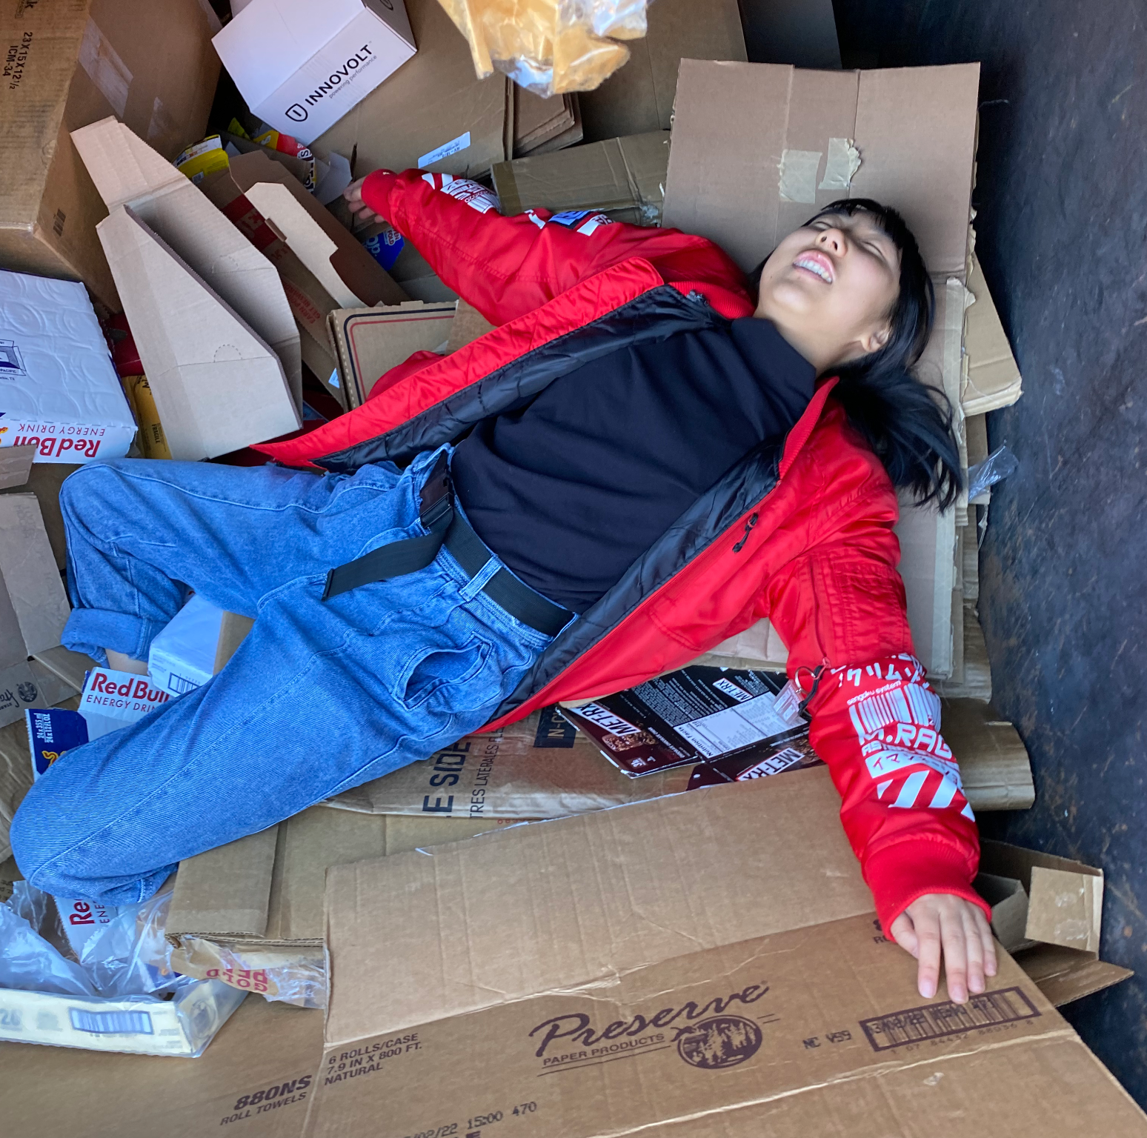

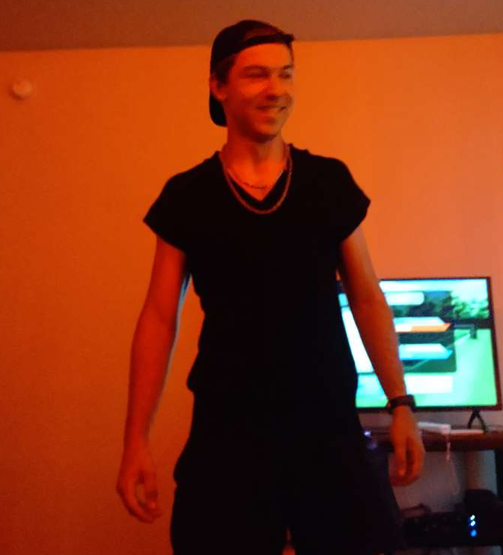


Created By
HARRISON HOYTT
SARAH HUANG
BEAR MORAN
RYLAND SEAGRAVES
KUBA ZELGOWSKI
Hydroplane Harold
Notes:
Ain’t no way a shrimp fried all this rice

Slide 3
How To Play
What is Nulltime?
Nulltime is the greatest game to ever exist the virtual form of the party game “Fishbowl” or “Time’s Up”.
What are the rules?
Fishbowl/Time’s Up is as if charades and an office icebreaker game had a child, except fun.
Round 1: Guess the card with as many words as you want
Round 2: Guess the card using only one word
Round 3: Guess the card using charades/motions and no talking
Why would we make such a thing?
In ye olden days, the setup for Fishbowl was exceptionally tedious, requiring a writing utensil and many scraps of paper. Just for a game that only lasted 20 minutes! We wanted to change that.

Slide 4
Features
Benefits of Being Digital
Play the game without needing paper and pencil with digital cards!
Save time by not having to write all your words down. You type them!
It works on your phone!
There’s music and sound effects!
Technology
Angular
Typescript
SASS
Node
SQL database
Kotlin for the backend server

Slide 5

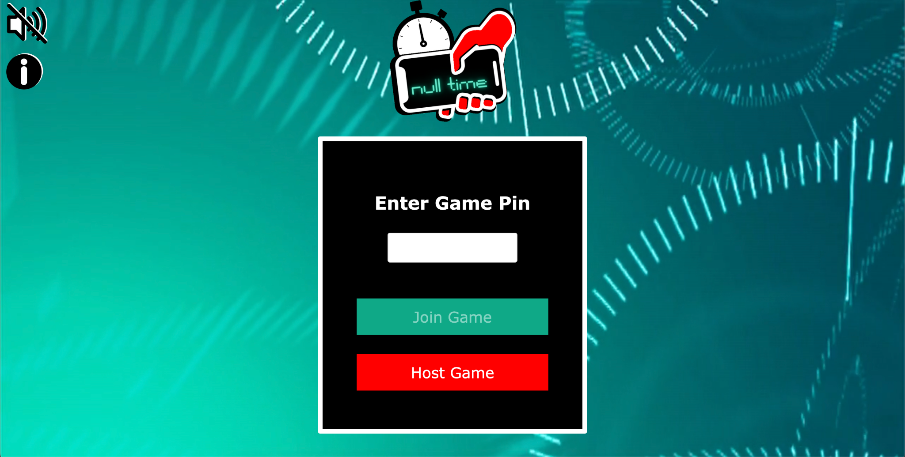
Demo

Slide 6
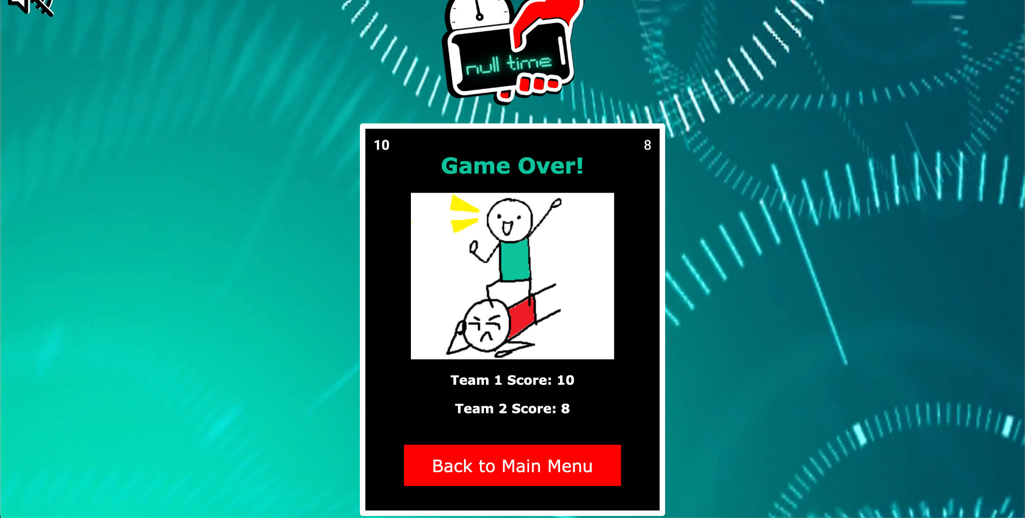
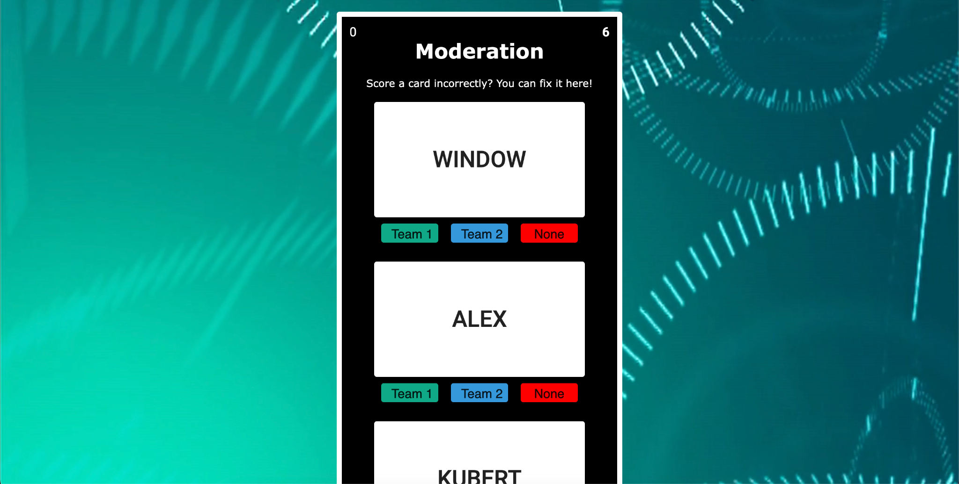
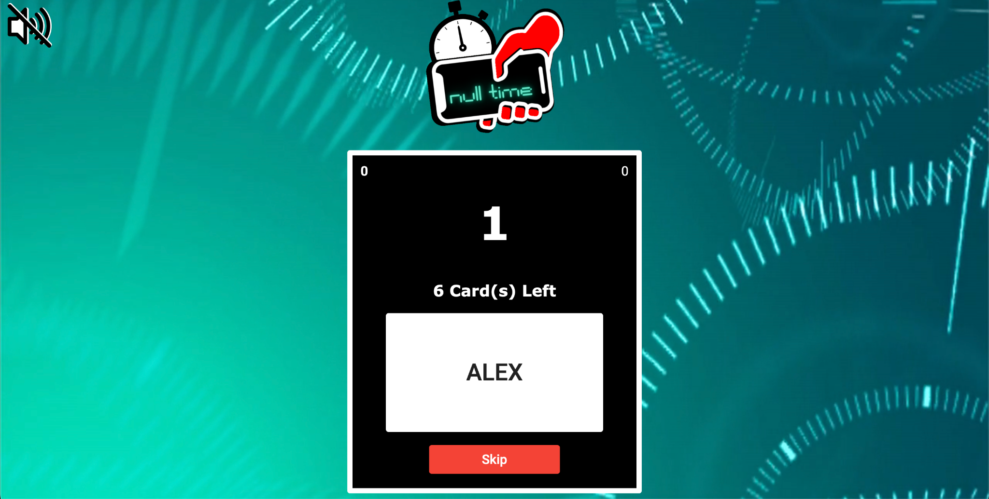
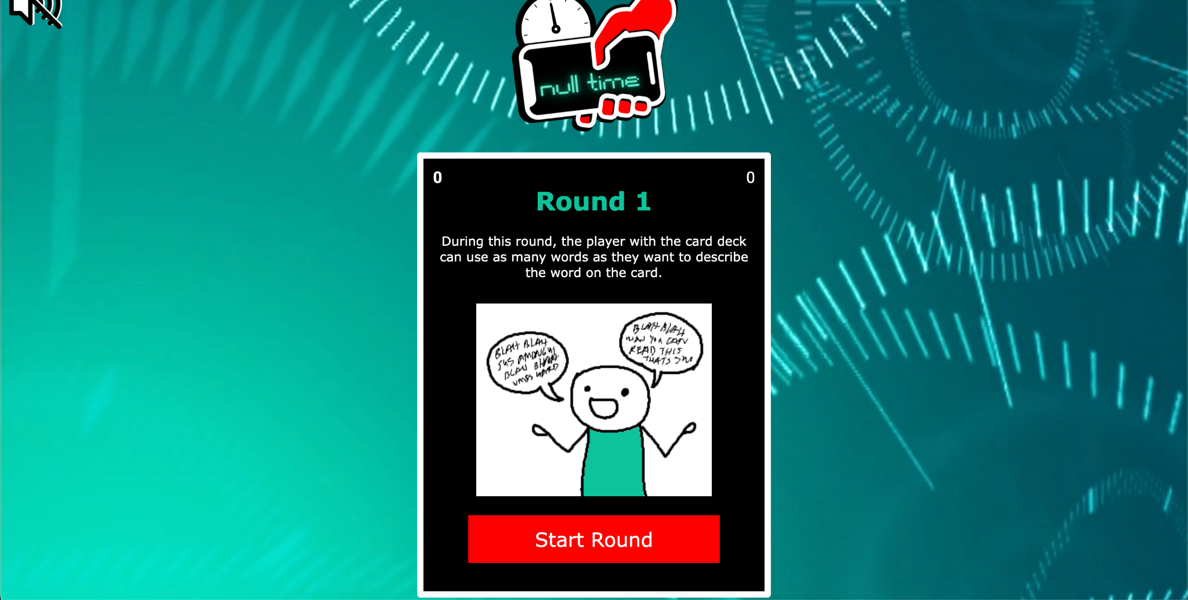
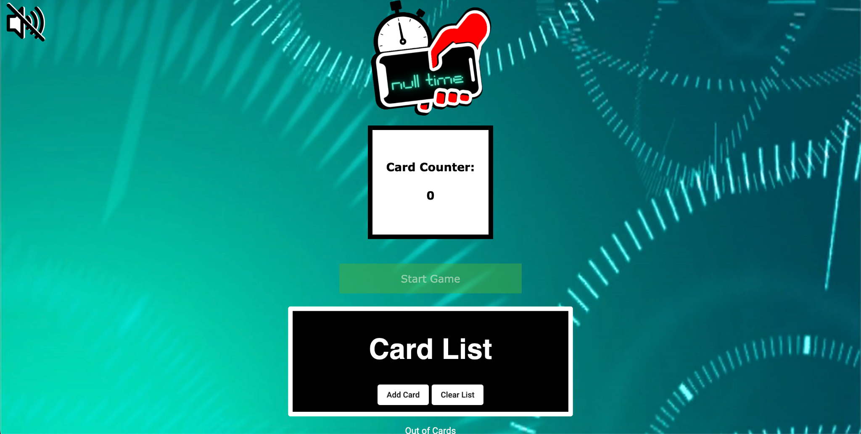
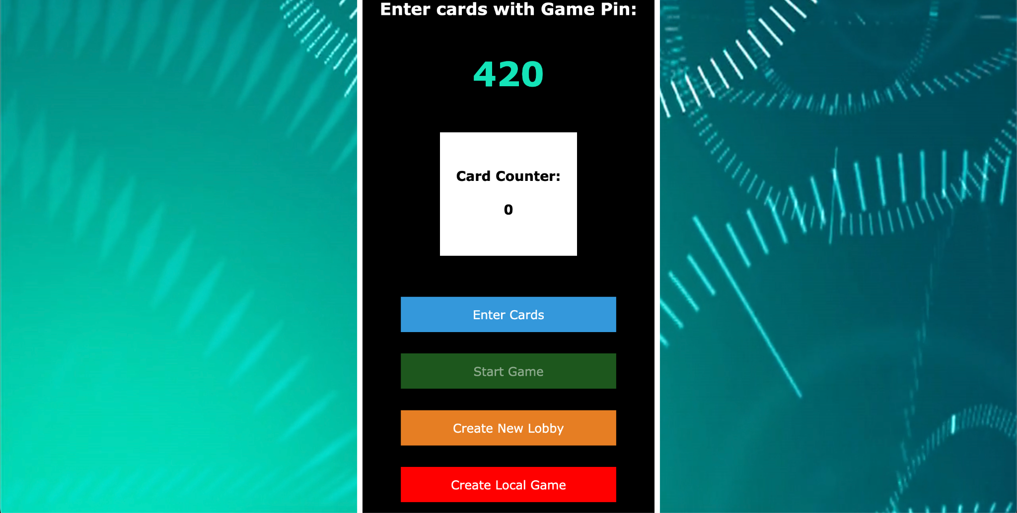
The Main Menu

Slide 7
Lobby

Slide 8
The Card List

Slide 9
Pre-round Instructions

Slide 10
In Game

Slide 11
Moderation

Slide 12
Game Over

Slide 13
Questions?

